Slide 1

Astronauts vs. Aliens
335
Created by Adrian Bao, Trey Bryant, Mauricio Herrera & Tim Lukau

Slide 2

Overview
Modeled after Plants vs. Zombies
Placeable towers to defend against waves of Aliens
Alien waves, with increasing difficulty and variety, attempting to bypass Player defenses
Multiple stages with map restrictions, increasing difficulty

Slide 3
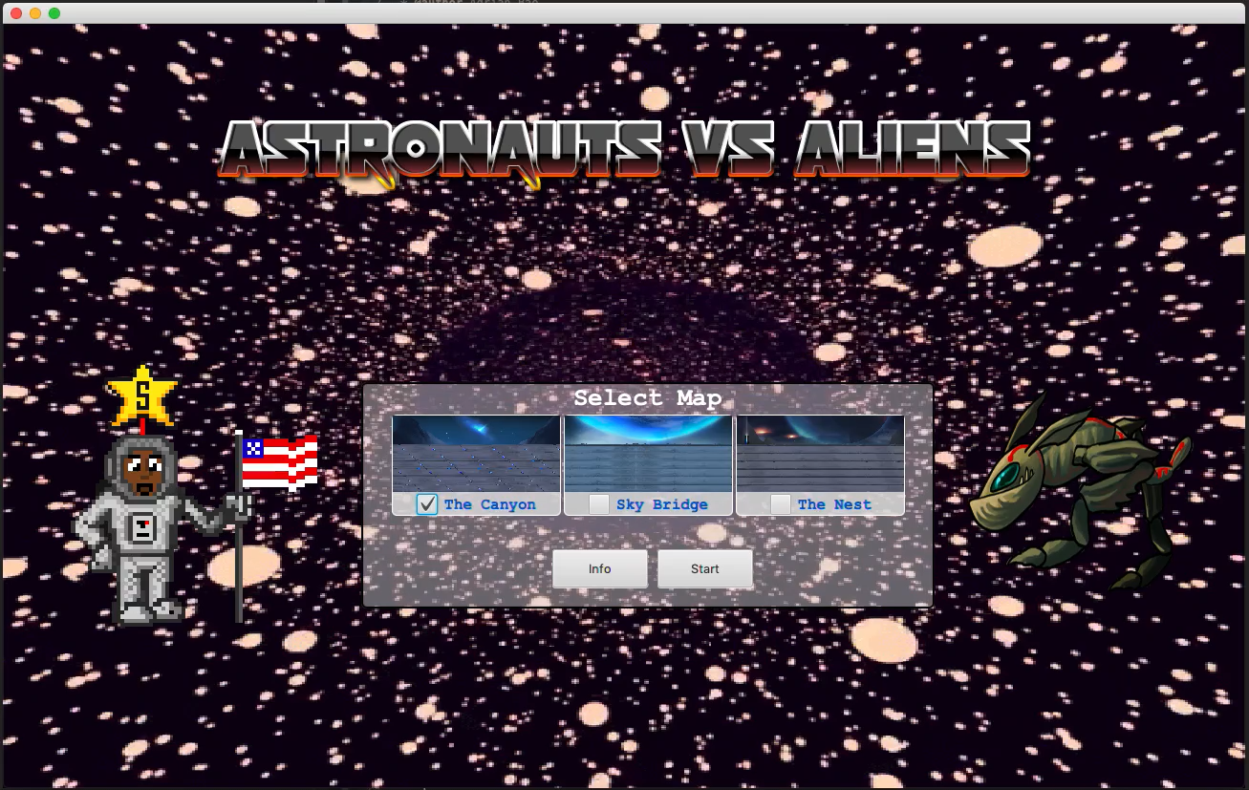
Start Menu
Presents the player with various customizations for gameplay
Selecting Maps
Selecting Game Modes
Info button provided to explain how to play and tips to getting started as well as detailed stats of all characters in the game

Slide 4
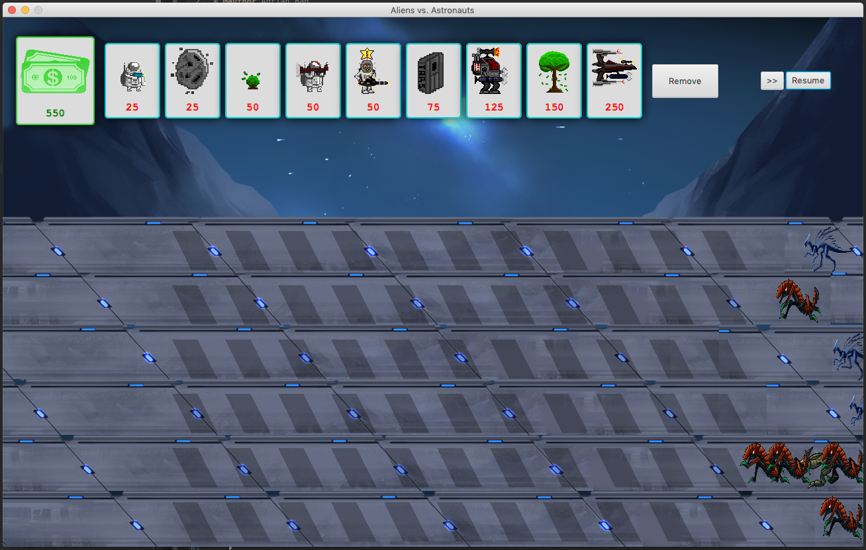
Game Stage – UI Elements
Collection of ‘Defender Cards’
Each DefenderTower has their own Drag & Drop functionality
Remove Button
Fast-forward & Pause Buttons
Grid of StackPanes for Tower placement/removal

Slide 5
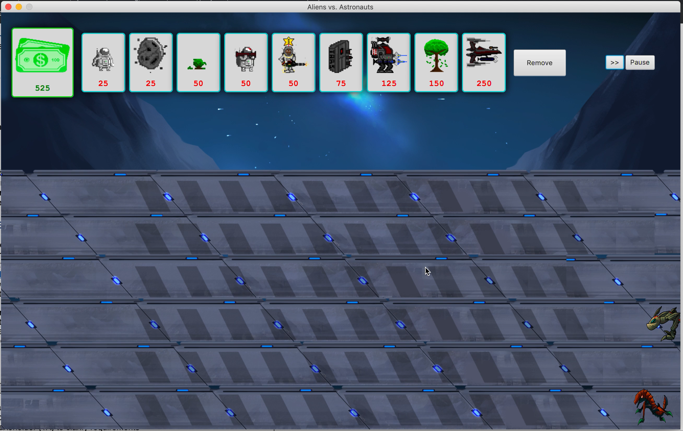
Game Stage – Gameplay
Tower placement/removal is done via Drag & Drop
Each DefenderTower has their own Animation/Ammo
If any Alien reaches the furthest left column, the game is lost
3 waves of increasing difficulty

Slide 6

AvA Design
MVC Design Pattern
Multitude of DefenderTower & Enemy Subclasses that range in gameplay attributes
Health, Attack Speed, Damage, etc…
Currency System (Passive & Active)
Configurable play field that was extended in a later feature
GIFS vs Sprite Animations
Linear Organization
Sound Effects

Slide 7
Wow Factor No. 1
Character Variety
9 Total Defenders and 6 Total Enemies
Each custom Defender has a unique arsenal/attribute it provides to the gameplay
Typical weaponized towers
Active income towers
Damage sponge
Each Alien has its own set of unique attributes that make some peskier than others
Movement speed
Health
Damage

Slide 8
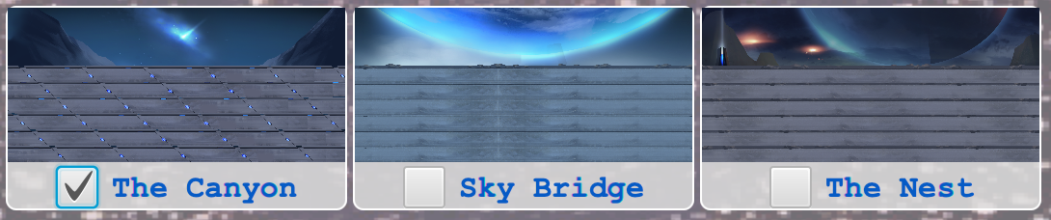
Wow Factor No. 2
Additional Stages
3 total stages
The Canyon (Easy)
Sky Bridge (Medium)
The Nest (Hard)
Each sequential stage places acid pools on more Tiles in order to restrict the player from placing Defense Towers in those positions

Slide 9
Wow Factor No. 3
Additional Mode
Double cost game mode was introduced as a challenge mode to add an additional play style the player may choose to pursue.
We initially wanted to implement endless mode but could not implement it in time for submission.

